Slide 1
Celebremos
Lets celebrate

Slide 2
Team Members
Hari Priya Jupally
Poojitha Singam
Sai Ram Badisa
Karun Bourishetty
Vishal Pannala
Indra Reddy Mamidi
Saikumar Nalivela

Slide 3
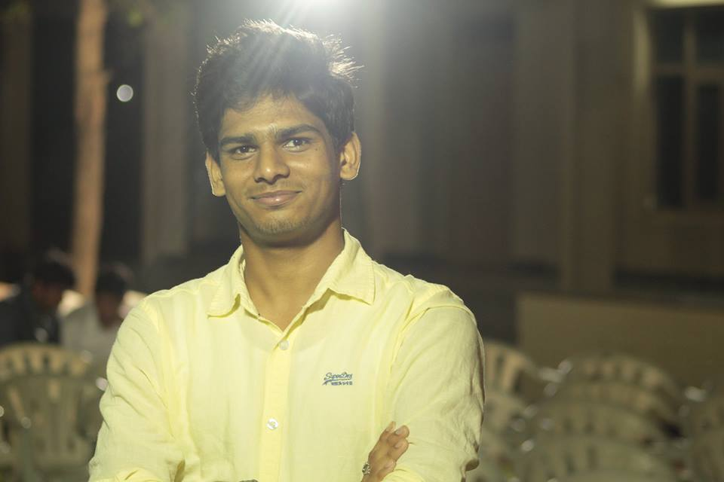
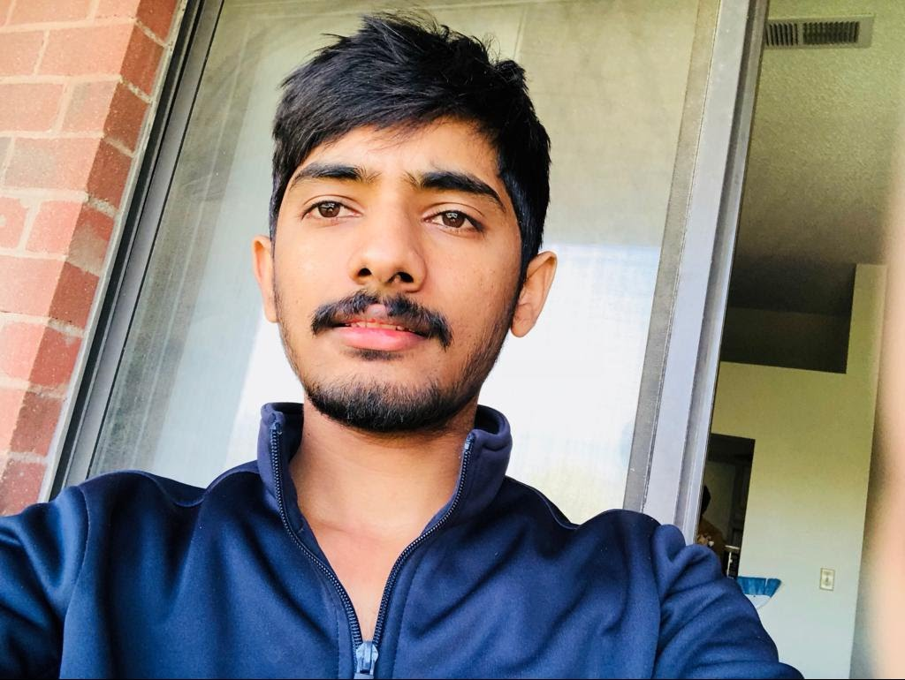
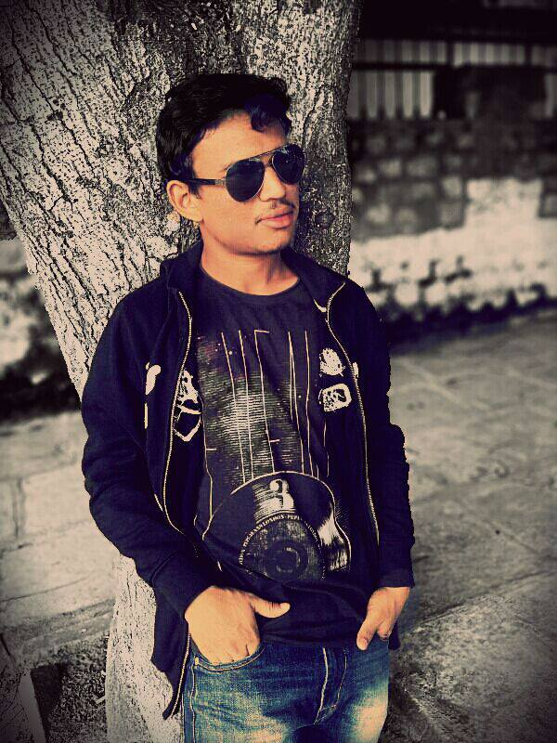
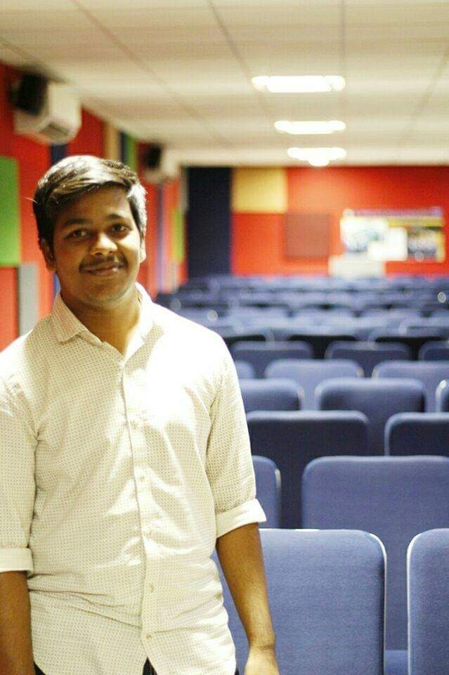
Presenting team members
SaiKumar Nalivela
Indra Reddy Mamidi
Vishal Reddy Pannala
Karun Bourishetty

Slide 4
contents
Project Introduction
Scope and Purpose
User Requirements
Analysis
Design
Implementation
Testing
Conclusion
SaiKumar Nalivela

Slide 5
introduction
The main purpose of the application is to create, modify and delete an online invitation system.
This application helps the event organizers to manage the number of guests attending the event.
This application helps in creating polls to finalize the menu.
This application helps the event organizers to plan the event successfully without any issues.
SaiKumar Nalivela

Slide 6
Scope and purpose
To create an web based application that helps the event organizers to invite the guests to party.
It helps organizers to manage the number of people coming to event.
It helps the organizers to plan for the place, food items, number of guests coming for party.
SaiKumar Nalivela

Slide 7
User requirements
Creating sign-up page
Creating sign-in page
Editing invitation page
Adding guest page
Creating Confirmation page
Creating dashboard page
SaiKumar Nalivela

Slide 8
Planning
Define the problem statement and scope of project.
Overview the new system and determine its objectives.
Produce the project Schedule.
Consider threats, constraints, integration and security of system.
Submit the project feasibility to client.
Submit the cost estimation
SaiKumar Nalivela

Slide 9
Analysis
Gather, analyze, and validate the information.
Define the requirements and prototypes for new system.
Evaluate the alternatives and prioritize the requirements.
Examine the information needs of end-user and enhances the system goal.
Update Software Requirement Specification (SRS) document.
SaiKumar Nalivela
Notes:
which specifies the software, hardware, functional, and network requirements of the system is prepared at the end of this phase.

Slide 10
Design
Create the design of application, network, databases, user interfaces, and system interfaces.
Transform the SRS document into logical structure.
Review the proposed design.
Finally, prepare a design document which will be used during next phases.
SaiKumar Nalivela
Notes:
Transform the SRS document into logical structure, which contains detailed and complete set of specifications that can be implemented in a programming language.
Review the proposed design. Ensure that the final design must meet the requirements stated in SRS document.

Slide 11
implementation
To develop the design into source code through coding in preferred language.
Combine all the modules together into training environment that detects errors and defects.
SaiKumar Nalivela

Slide 12
Technologies
Main Technologies which we use are:
MEAN ( Mongo dB, Express, Angular, Node).
Html.
CSS and JavaScript.
Tools are:
Adobe Xd.
Lucid Chart.

Slide 13
Testing
Testing is the process of evaluating a applicaton with the intent to find whether it satisfies the specified requirements or not.
Testing is done by :
Software Tester
Software Developer
Project Lead/Manager
End User

Slide 14
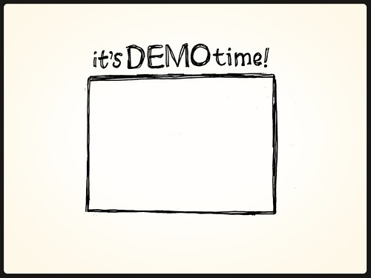
SaiKumar Nalivela

Slide 15
Summary
User requirements are collected perfectly.
Analysis and design processes helped us to improve the understanding of the requirements
Implementation is started along with testing the application
SaiKumar Nalivela

Slide 16
Any queries ???
SaiKumar Nalivela
Indra Reddy Mamidi
Vishal Reddy Pannala
Karun Bourishetty

Slide 17

Thank you !

